Slide 1
Propositional Logic

Slide 2
Imperative/procedural programming
An approach to programming where the program is a sequence of statements
C++, Python, …
Imperative programming focuses on describing how a program operates

Slide 3
Declarative programming
Inference engine
Domain-independent algorithms
Knowledge base (KB)
Domain-specific content (facts)
Knowledge base = set of sentences in a formal language
Declarative approach to building an agent:
Tell it what it needs to know
Then it can Ask itself what to do - answers should follow from the KB

Slide 4
Some Knowledge Representation Languages
Propositional Logic
Predicate Calculus
Frame Systems
Influence Diagrams
Semantic Networks
Nonmonotonic Logic
Concept Description Languages
Rules with Certainty Factors
Bayesian Networks

Slide 5
Some Knowledge Representation Languages
All popular knowledge representation systems are equivalent to (or a subset of)
Logic
Either Propositional Logic
Or Predicate Calculus
Probability Theory
E.g.,: Bayesian networks

Slide 6
Wumpus world
4x4 grid world
In the squares adjacent to the wumpus, you will get a stench
In the square adjacent to a pit, you will feel a breeze
In the square where the gold is, you will see a glitter
You die if you enter a square containing a pit or a wumpus
You can move one step in any direction
Start from (1,1)
Goal:
Move through the grid to get the gold without getting killed (by either the wumpus or pit)

Slide 7
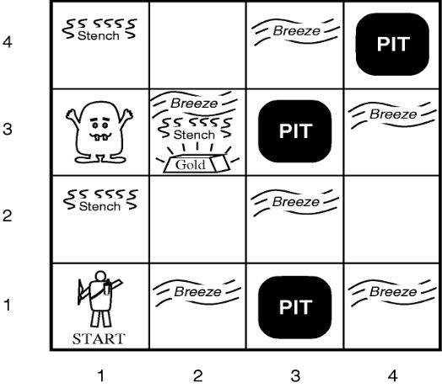

Slide 8
Wumpus world logic
if you sense a stench, then you knows the wumpus must be in the front or left or right square.
if you feel a breeze, then it knows the PIT must be in the front or left or right square.
if no stench and no breeze, all directly adjacent squares are safe.

Slide 9
Wumpus world characterization
Fully Observable No – only local perception Deterministic Yes – outcomes exactly specified Static Yes – Wumpus and Pits do not move Discrete Yes Single-agent? Yes – Wumpus is essentially a natural feature

Slide 10
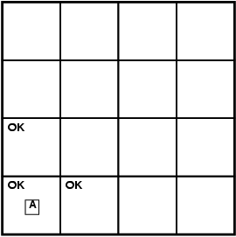
Exploring a wumpus world

Slide 11
Exploring a wumpus world

Slide 12
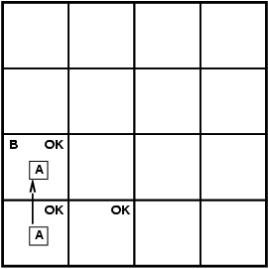
Exploring a wumpus world

Slide 13
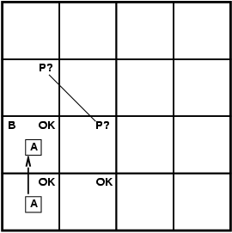
Exploring a wumpus world

Slide 14
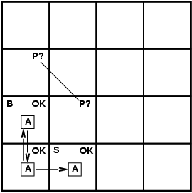
Exploring a wumpus world

Slide 15
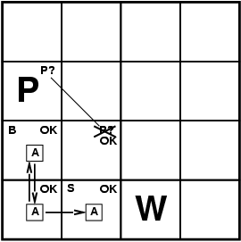
Exploring a wumpus world

Slide 16

Exploring a wumpus world

Slide 17
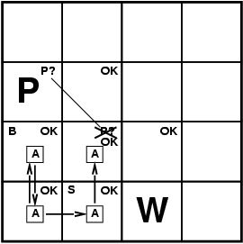
Exploring a wumpus world

Slide 18
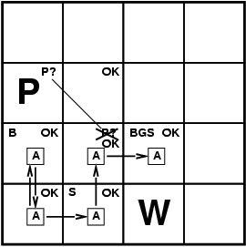
Exploring a wumpus world

Slide 19
Basic Idea of Logic
By starting with true assumptions, you can deduce true conclusions.
Algorithm
Sentences
Sentences
Knowledge Representation
World
Follows
Facts
Facts
Notes:
But what is TRUTH?

Slide 20
Propositional logic
Symbolic logic for manipulating propositions
Can be classified as either TRUE or FALSE
Logical constants: true, false
Propositional symbols: P, Q, S, ... (atomic sentences)
Wrapping parentheses: ( … )
Sentences are combined by connectives:
∧ ...and [conjunction]
∨ ...or [disjunction]
→...implies [implication / conditional]
↔..is equivalent [biconditional]
~ ...not [negation]
Literal: atomic sentence or negated atomic sentence

Slide 21
Examples
P
~Q
Q → P
(P ∧ Q) → R

Slide 22
Syntax
A sentence is defined as follows:
A symbol is a sentence
If S is a sentence, then ~S is a sentence
If S is a sentence, then (S) is a sentence
If S and T are sentences, then (S ∨ T), (S ∧ T), (S → T), and (S ↔ T) are sentences
A sentence results from a finite number of applications of the above rules
Well formed formula, WFF

Slide 23
Semantics
User defines the set of propositional symbols: P, Q, …
User defines the semantics (meaning) of each propositional symbol:
P means “It is hot.”
Q means “It is humid.”
R means “It is raining.”
(P ∧ Q) → R
“If it is hot and humid, then it is raining”
Q → P
“If it is humid, then it is hot”

Slide 24
Syntax: which arrangements of symbols are legal sentences
“Well-formed formulae”
Semantics: what the symbols mean in the world
(Mapping between symbols and worlds)
Inference
Sentences
Sentences
Representation
Semantics
Semantics
World
Follows
Facts
Facts
Notes:
But what is TRUTH?

Slide 25
Truth tables
A | ~A
T | F
F | T
A | B | A ∨ B
T | T | T
T | F | T
F | T | T
F | F | F
A | B | A ∧ B
T | T | T
T | F | F
F | T | F
F | F | F
A | B | A → B
T | T | T
T | F | F
F | T | T
F | F | T

Slide 26
Truth value of a sentence
Given the truth values of all symbols in a sentence, it can be “evaluated” to determine its truth value (True or False).
Truth table
P
~P
P ∧ Q
Q → P
(P ∧ Q) → R

Slide 27
Knowledgebase (KB) with Propositional Logic
KB contains a set of propositional logic formulae that are known to be true
The premises
Question?
Are there other formulae that are also true given this specific KB?

Slide 28
Logical Entailment
Entailment: KB ╞ Q
Q is entailed by KB if and only if the conclusion is true for every logically possible world in which all the premises in KB are true.

Slide 29
Entailment and derivation
Entailment: KB ╞ Q
Q is entailed by KB if and only if the conclusion is true for every logically possible world in which all the premises in KB are true.
Derivation: KB Ⱶ Q
We can derive Q from KB if there is a proof consisting of a sequence of valid inference steps starting from the premises in KB and resulting in Q

Slide 30
Two important properties for inference
Soundness: If KB Ⱶ Q then KB ╞ Q
If Q is derived from a set of sentences KB using a given set of rules of inference, then Q is entailed by KB.
Hence, inference produces only real entailments, or any sentence that follows deductively from the premises is valid.
Completeness: If KB ╞ Q then KB Ⱶ Q
If Q is entailed by a set of sentences KB, then Q can be derived from KB using the rules of inference.
Hence, inference produces all entailments, or all valid sentences can be proved from the premises.

Slide 31
Proof methods
Proof methods divide into (roughly) two kinds:
Application of inference rules
Legitimate (sound) generation of new sentences from old Proof = a sequence of inference rule applications Can use inference rules as operators in a standard search algorithm Typically require transformation of sentences into a normal form
Model checking
truth table enumeration improved backtracking, e.g., Davis--Putnam-Logemann-Loveland (DPLL) heuristic search in model space (sound but incomplete)
e.g., hill-climbing algorithms

Slide 32
“Proofs” using a truth table
If we have a finite number of premises, then we can build a truth table
Exhaustively test every possible “world”
Check if every case where all premises are true, the conclusion is also true

Slide 33
“Proofs” using a truth table
P | Q * | R | (P ∧ Q) → R * | Q → P * | R (concl)
True | T | T | T | T | T (all prem true)
T | T | F | F | T | F
T | F | T | T | T | T
T | F | F | T | T | F
F | T | T | T | F | T
F | T | F | T | F | F
F | F | T | T | T | T
F | F | F | T | T | F
Premises (KB)
Q
(P ∧ Q) → R
Q → P
Does R follow?
Yes
A | B | A → B
T | T | T
T | F | F
F | T | T
F | F | T

Slide 34
“Proofs” using a truth table
P | Q * | R | (P ∧ Q) → R * | Q → P * | R
True | T | T | T | T | T (concl. True)
T | T | F | F | T | F
T | F | T | T | T | T
T | F | F | T | T | F
F | T | T | T | F | T
F | T | F | T | F | F
F | F | T | T | T | T
F | F | F | T | T | F
Premises (KB)
Q
(P ∧ Q) → R
Q → P
Does R follow?
Yes
A | B | A → B
T | T | T
T | F | F
F | T | T
F | F | T

Slide 35
“Proofs” using a truth table
Can we prove something does not follow?
P→Q
~Q→R
R
Does P follow?
No
P | Q | R * | P→Q * | ~Q→R * | P
True | T | T | T | T | True (ok)
T | T | F | T | T | T
T | F | T | F | T | T
T | F | F | F | F | T
F | T | T | T | T | F (wrong)
F | T | F | T | T | F
F | F | T | T | T | F (wrong)
F | F | F | T | F | F

Slide 36
“Proofs” using a truth table
Can we prove something does not follow?
P→Q
~Q→R
R
Does P follow?
No
P | Q | R * | P→Q * | ~Q→R * | P
True | T | T | T | T | T
True | T | F | T | T | True
T | F | T | F | T | T
T | F | F | F | F | T
F | T | T | T | T | F (concl is FALSE)
F | T | F | T | T | F
F | F | T | T | T | F(concl is FALSE)
F | F | F | T | F | F

Slide 37
Classwork
Given
P →( Q→R)
Q
Does this follow?
P → R
Use
Truth table

Slide 38
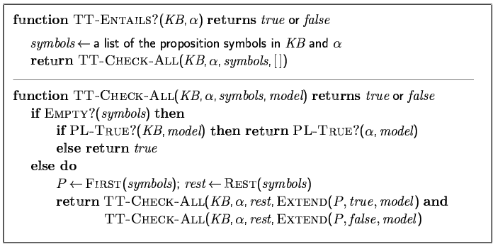
Inference by enumeration (truth tables)
Depth-first enumeration of all models is sound and complete
For n symbols, time complexity is O(2^{n}), space complexity is O(n)

Slide 39
Rules of inference
Logical inference is used to create new sentences that logically follow from a given set of sentences (KB).
An inference rule is sound if every sentence X produced by an inference rule operating on a KB logically follows from the KB.
The inference rule does not create any contradictions

Slide 40
Sound (correct) rules of inference
RULE PREMISE CONCLUSION
Modus Ponens A, A → B B
AND Introduction A, B A ∧ B
AND Elimination A ∧ B A
Double Negation ~~A A
Resolution A ∨ B, ~B ∨ C A ∨ C
Unit resolution A ∨ B, ~B A
Each can be shown to be sound/correct using a truth table

Slide 41
Modus ponens is sound
A | B | A → B
True | True | True
True | False | False
False | True | True
False | False | True
Premise: A, A → B
Conclusion: B
conclusion is true whenever the premise is true

Slide 42
Proofs
A proof is a sequence of sentences, where each sentence is either a premise or a sentence derived from earlier sentences in the proof by one of the rules of inference.
The last sentence is the theorem (also called goal or query) that we want to prove.

Slide 43
Example of a proof
Premises
Q
(P ∧ Q) → R
Q → P
How to prove?
R

Slide 44
Example of a proof
Q
Premise 1
Q → P
Premise 3
P
Modus ponens on 1 and 2
(P ∧ Q) → R
Premise 2
(P ∧ Q)
AND introduction on 1 and 3
R
Modus ponens on 4 and 5

Slide 45
Resolution algorithm
Disadvantages of our derivation method
Which rule of inference to apply?
Apply to which sentences?
Needed: an algorithm – can be executed by a computer
Alan Robinson, 1965

Slide 46
Resolution rule
RULE PREMISE CONCLUSION
Modus Ponens A, A → B B
AND Introduction A, B A ∧ B
AND Elimination A ∧ B A
Double Negation ~~A A
Resolution A ∨ B, ~B ∨ C A ∨ C
Unit resolution A ∨ B, ~B A
This single rule
is sufficient

Slide 47
Is resolution sound (correct)?
Show is sound/correct using a truth table

Slide 48
Applying the resolution rule
First, Convert to Conjunctive Normal Form (CNF)
CNF: Knowledgebase (KB) is a conjunction of disjunctions
Example: (A ∨ B) ∧ (A ∨ ~C) ∧ (~B ∨ ~C)
KB can then be represented as a list of conjunctions:
A ∨ B
A ∨ ~C
~B ∨ ~C

Slide 49
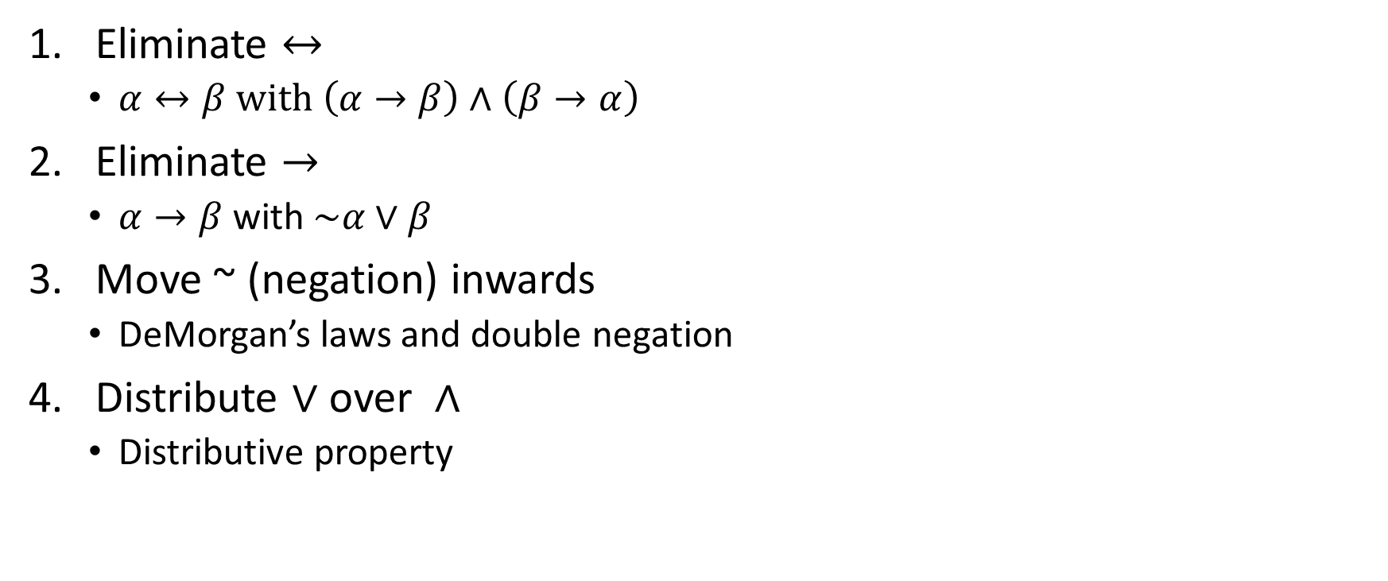
Convert to CNF
Eliminate $↔$
$α↔β with \left(α→β\right)∧\left(β→α\right)$
Eliminate $→$
$α→β$ with $\sim α∨β$
Move ~ (negation) inwards
DeMorgan’s laws and double negation
Distribute $∨$over $∧$
Distributive property

Slide 50


CNF: Eliminate $→$
$α→β$ is equivalent to $\sim α∨β$

Slide 51
CNF: Dealing with parentheses
DeMorgan’s laws
~(A ∨ B) ≡ ~A ∧ ~B
~(A ∧ B) ≡ ~A ∨ ~B
Distributive property
(A ∧ B) ∨ C ≡ (A ∨ C) ∧ (B ∨ C)

Slide 52
Examples: convert to CNF
~(~P ∨ Q)
~(~P ∨ Q) ∨ R
(P → Q) → R

Slide 53
Examples: convert to CNF
~(~P ∨ Q)
~~P ∧ ~Q
P ∧ ~Q
P
~Q
~(~P ∨ Q) ∨ R
(P ∧ ~Q) ∨ R
(P ∨ R) ∧ (~Q ∨ R)
P ∨ R
~Q ∨ R
(P → Q) → R

Slide 54
Proof by Resolution Refutation
Does Premise (KB) → Conclusion (α)?
Convert all premise sentences (KB) to CNF
Add the negated conclusion
Repeatedly apply rule of resolution until
Derive FALSE (contradiction): Conclusion is valid
Can’t apply any more: Conclusion cannot be proved
Proof by contradiction

Slide 55
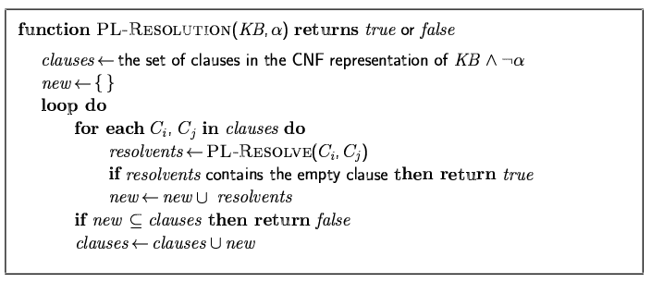
Resolution algorithm
Proof by contradiction, i.e., show KB∧¬α is unsatisfiable Resolution is sound and complete for propositional logic

Slide 56
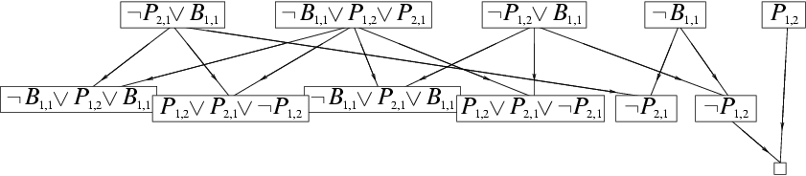
Resolution example
KB = (B_{1,1} ⇔ (P_{1,2}∨ P_{2,1})) ∧¬ B_{1,1}
α = ¬P_{1,2}

Slide 57
Example 1
Premise:
P ∨ Q
P → R
Q → R
Prove:
R
P ∨ Q
~P ∨ R
~Q ∨ R
~R
Q ∨ R
Resolution on 1,2
R
Resolution on 3,5
FALSE
Resolution on 4,6

Slide 58
Example 2
Premise:
P ∨ Q
P → R
Q → R
Prove:
~R

Slide 59
Classwork
Given
P →( Q→R)
Q
Does this follow?
P → R
Use
Resolution

Slide 60

Resolution
Premises (given)
P →( Q→R)
~Pv(Q →R)
~Pv(~QvR)
~P v ~Q v R
Q
Already in CNF
Negated conclusion
~(P → R)
P $∧\sim R$
P
$\sim R$
~P v ~Q v R
Q
P
$\sim R$
~P v R (resolving 1,2)
R (resolving 3,5)
FALSE (resolving 4,6)
Thus, the conclusion P → R is valid

Slide 61
Proof by Resolution Refutation
Sound
The answer is always correct
Complete
It always generates an answer

Slide 62
Efficient proofs
Not every application of resolution is needed
Unit preference
prefer a resolution step involving an unit clause (clause with one literal)
Produces a shorter clause
Set of support
Choose a resolution involving the negated goal or any clause derived from the negated goal

Slide 63
Wumpus world
4x4 grid world
In the squares adjacent to the wumpus, you will get a stench
In the square adjacent to a pit, you will feel a breeze
In the square where the gold is, you will see a glitter
You die if you enter a square containing a pit or a wumpus
You can move one step in any direction
Start from (1,1)
Goal:
Move through the grid to get the gold without getting killed (by either the wumpus or pit)

Slide 65
Wumpus world logic
if you sense a stench, then you knows the wumpus must be in the front or left or right square.
if you feel a breeze, then it knows the PIT must be in the front or left or right square.
if no stench and no breeze, all directly adjacent squares are safe.

Slide 66
Wumpus world logic
Develop a propositional logic system to decide where to move
What symbols?

Slide 67

Wumpus world logic symbols
$P_{x,y}$: pit in (x,y)
$W_{x,y}$: wumpus in (x,y)
$B_{x,y}$: agent perceives breeze in (x,y)
$S_{x,y}$: agent perceives stench in (x,y)

Slide 68
Wumpus world logic
Develop a propositional logic system to decide where to move
What symbols?
How to represent:
S11 = None ⇒ S12 = Safe ∧ S21 = Safe

Slide 69
Inference-based agents in the wumpus world
A wumpus-world agent using propositional logic:
¬P_{1,1}
¬W_{1,1}

Slide 70
Inference-based agents in the wumpus world
A wumpus-world agent using propositional logic:
¬P_{1,1}
¬W_{1,1}
Rules for breeze and stench?

Slide 71
Inference-based agents in the wumpus world
A wumpus-world agent using propositional logic:
¬P_{1,1}
¬W_{1,1}
Rules for breeze and stench:
B_{x,y} ⇔ (P_{x,y+1} ∨ P_{x,y-1} ∨ P_{x+1,y} ∨ P_{x-1,y})
S_{x,y} ⇔ (W_{x,y+1} ∨ W_{x,y-1} ∨ W_{x+1,y} ∨ W_{x-1,y})

Slide 72
Inference-based agents in the wumpus world
A wumpus-world agent using propositional logic:
¬P_{1,1}
¬W_{1,1}
B_{x,y} ⇔ (P_{x,y+1} ∨ P_{x,y-1} ∨ P_{x+1,y} ∨ P_{x-1,y})
S_{x,y} ⇔ (W_{x,y+1} ∨ W_{x,y-1} ∨ W_{x+1,y} ∨ W_{x-1,y})
Exactly one wumpus?

Slide 73
Inference-based agents in the wumpus world
A wumpus-world agent using propositional logic:
¬P_{1,1}
¬W_{1,1}
B_{x,y} ⇔ (P_{x,y+1} ∨ P_{x,y-1} ∨ P_{x+1,y} ∨ P_{x-1,y})
S_{x,y} ⇔ (W_{x,y+1} ∨ W_{x,y-1} ∨ W_{x+1,y} ∨ W_{x-1,y})
Exactly one wumpus:
W_{1,1} ∨ W_{1,2} ∨ … ∨ W_{4,4}
¬W_{1,1} ∨ ¬W_{1,2}
¬W_{1,1} ∨ ¬W_{1,3}

Slide 74
Inference-based agents in the wumpus world
A wumpus-world agent using propositional logic:
¬P_{1,1}
¬W_{1,1}
B_{x,y} ⇔ (P_{x,y+1} ∨ P_{x,y-1} ∨ P_{x+1,y} ∨ P_{x-1,y})
S_{x,y} ⇔ (W_{x,y+1} ∨ W_{x,y-1} ∨ W_{x+1,y} ∨ W_{x-1,y})
W_{1,1} ∨ W_{1,2} ∨ … ∨ W_{4,4}
¬W_{1,1} ∨ ¬W_{1,2}
¬W_{1,1} ∨ ¬W_{1,3}
…
⇒ 64 distinct proposition symbols, 155 sentences

Slide 75
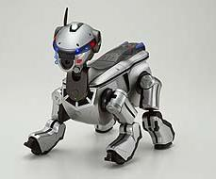

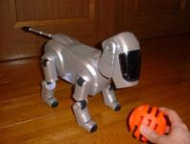

Embedding reasoning into a Sony Aibo robot

Slide 76
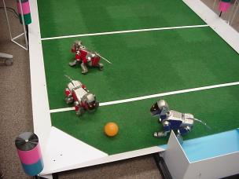
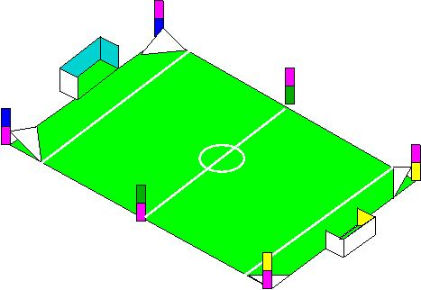
Embedding reasoning into a Sony Aibo robot

Slide 77
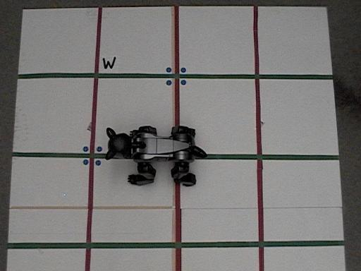
Embedding reasoning into a Sony Aibo robot
reasoning algorithms based on PL could be executed even on low-power computer platforms if
efficient representation of Boolean propositions are used
The plan to solve the Wumpus world problem is computed offline and stored as an Ordered Binary Decision Diagram (OBDD) in the robot's memory.

Slide 78
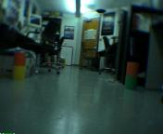
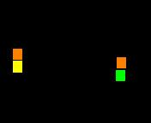
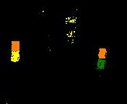
Embedding reasoning into a Sony Aibo robot
The robot uses its vision system to identify its location in the grid world
then instantiates the appropriate variables in the OBDD.

Slide 79
Embedding reasoning into a Sony Aibo robot
The instantiated action variable determines the direction in which the robot is to move.

Slide 80
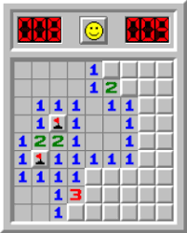
Classwork: Minesweeper
Minesweeper is related to the Wumpus world.
The minesweeper world is a rectangular grid with invisible mines scattered around it. Any cell may be probed by the player; instant death follows if a mine is probed. Minesweeper indicates the presence of mines by revealing, in each probed cell, the number of mines that are directly or diagonally adjacent. The goal is to probe every unmined cell.
Let proposition Xij = True (where i=0,1,2,… and j=0,1,2,…) denote that cell (i,j) contains a mine.
Let probing the corner cell (0,0) reveal 1 mine in an adjacent cell. How can the assertion that exactly one mine is adjacent to (0,0) be expressed in Propositional logic (as some logical combination of the Xij propositions)?

Slide 81
Limitations of logic

Slide 82
Contradiction in the premise
Premise:
P
~P
Prove:
C
P
~P
~C
FALSE (resolving 1,2)

Slide 83
Contradiction in the premise
P ∧ ~P → C is valid
Any conclusion can be proved from a contradiction
Pure logic systems are brittle

Slide 84
Expressiveness limitation of propositional logic
KB contains "physics" sentences for every single square
For every location [x,y] B_{x,y} ⇔ (P_{x,y+1} ∨ P_{x,y-1} ∨ P_{x+1,y} ∨ P_{x-1,y})
Rapid proliferation of clauses
Predicate logic introduces variables to logic

Slide 85
References
George F. Luger, Artificial Intelligence: Structures and Strategies for Complex Problem Solving, 6th edition, Addison Wesley, 2009.
Section 2.1
Russel and Norvig, Artificial Intelligence: A Modern Approach, 3rd edition, Prentice Hall, 2010.
Section 7.4 Propositional Logic: A Very Simple Logic
Section 7.5 Propositional Theorem Proving

